Slide 1

F.L.A.S.H. Family Life and Sexual Health at the K-4 level it’s called All About Life
If you could be born again and pick your gender, you would be
_______ Stay the same
_______ Change to the other gender
Words & descriptions introduced to the children at this age:
Vulva, vagina, clitoris, penis, scrotum, testicles

Slide 2

FLASH for 4, 5 and 6 Grade: The pornographic book, “It’s Perfectly Normal” is recommended for use now and on through the upper levels of the curriculum.

Slide 3
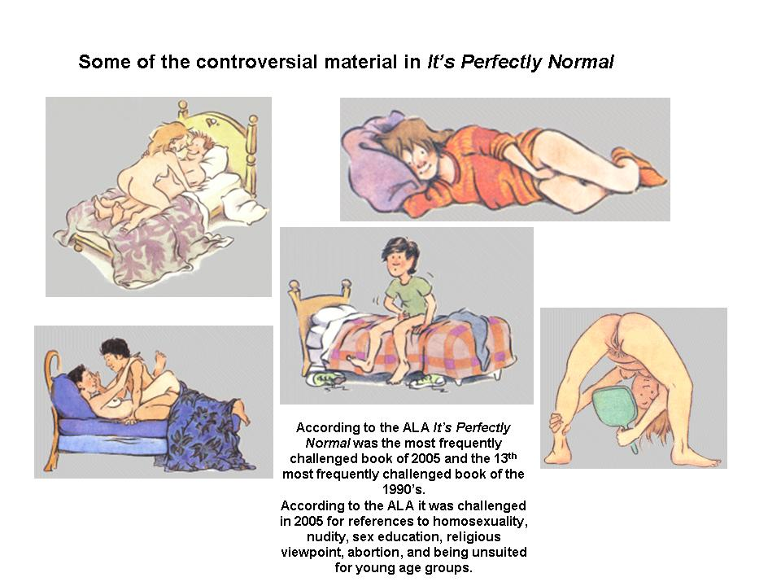

Slide 4
Family Life and Sexual Health, Grades 4, 5, and 6, Lesson 2 F.L.A.S.H.
Activity
Explain that this lesson will help students explain what families are for, and how they (your students)
contribute to their own families.
Define family.
A family is two or more people who love and take care of each other. Usually they are related and/or live
together. Families come in all shapes, sizes and descriptions.
OPTIONAL: Show the 35-minute documentary film That’s A Family and discuss it.
The film tells the stories, in their own words, of children in families with parents of different races or
religions, divorced parents, a single parent, gay or lesbian parents, adoptive parents or grandparents as
guardians.
The film also does not introduce every configuration of family. Discuss which types of families were
not portrayed (two-biological parent families, foster families and group homes, couples without
children, bigger and extended families living together).

Slide 5
Family Life and Sexual Health, Grades 4, 5, and 6, Lesson 9 F.L.A.S.H.
Crushes and attractions may begin (both) – Explain that although kindergartners may get crushes, too, they may feel more intense at puberty. It is the feeling of really wanting someone to like you. Of having your tummy feel funny when they walk in the room or when you hear their voice. Everybody will feel this eventually, but some people will notice it at this age and others may not notice those kinds of feelings until middle school, high school or even later. A person may have crushes on people of their own sex, the other sex or both. It may or may not predict how they will feel when they’re grown. That is, really liking someone of a different sex doesn’t necessarily mean you will eventually figure out that you are a heterosexual (straight). And, likewise, really liking someone of your own sex doesn’t necessarily mean that you will eventually figure out that you are gay or lesbian. It often takes time to figure out. There’s no rush.

Slide 6
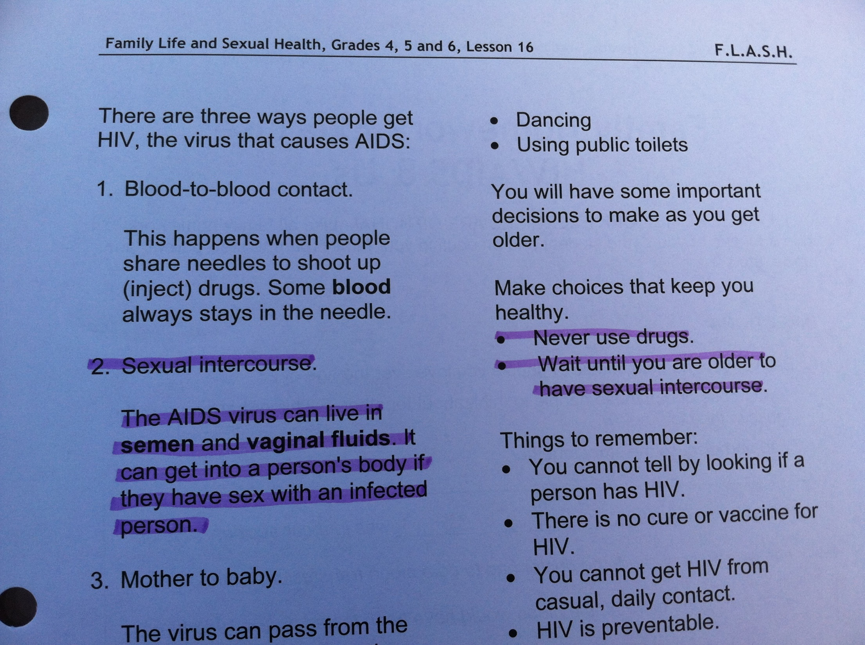

Slide 7
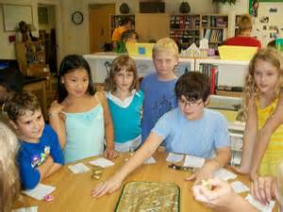
Family Life and Sexual Health, Grades 4, 5, and 6, Lesson 12 F.L.A.S.H.
Reproductive System Worksheet 4 (words that students are to know the correct definition of)
Circumcision Some of the definitions:
Conception
Ejaculation The penis or clitoris filling with blood and getting
Erection harder and larger.
Fertilization
Genitals The penis being inside the vagina.
Implantation
Intercourse Semen coming out of the penis.
Menstruation
Nocturnal emission Ejaculation during sleep (sometimes called “having a
Ovulation wet dream”)
Ovum
Pituitary
Puberty
Semen (Using these same words, students also play a
Sperm vocabulary bingo game! How fun!)

Slide 8

Family Life and Sexual Health, Grade 7 and 8, Lesson 14 F.L.A.S.H.
Activities:
1. Explain the relevance of today’s lesson.
Explain that today’s lesson is focusing on PEOPLE, not just teens, and emphasize that you are
not assuming that all your students - or even the majority - are having intercourse:
Today's lesson is on birth control. We are doing this lesson for three reasons. Some people
have intercourse in their teens. For them, knowing about birth control is important. That's one
reason we're studying it. Other people choose not to have intercourse in their teens, but almost
everyone - even those who wait until marriage or who are gay or lesbian - will have intercourse
at some time in his or her life. So, the second reason we're doing this is that most of you will
want to make decisions about birth control some day.

Slide 9

2. Brainstorm birth control methods, including abstinence.
Brainstorm all the kinds of birth control anyone in the class has heard of. If they include nonmethods
like douching (which doesn't work), male pills (which don't exist yet), or abortion (which
doesn't prevent pregnancy and is therefore not counted as a method of birth control) list them
separately from actual methods. This lesson will cover just 7 of the 17 methods (see endnote
for an explanation of why we chose these 7 to focus on) available in the United States – those
bolded in the list here – but write on the board any of these that students may know about,
adding just the bolded ones they may forget or not have heard of:
BEHAVIORAL: abstinence, withdrawal, fertility awareness, combining two methods (e.g.,
condoms with a hormonal method, like the pill).
BARRIER: “male” condom3, “female” condom4, diaphragm.
HORMONAL: the pill, the patch, the vaginal ring, the shot (Depo-Provera), the implant
(Implanon), hormonal IUD (Mirena intra-uterine device), emergency contraceptive (Plan B)
pills.
SPERMICIDES: foam, cream, gel, suppositories, tablets, film and the sponge.
OTHER: copper IUD (intra-uterine device), sterilization.

Slide 10
3. Introduce 7 methods, focusing on what each is and how it reduces pregnancy risk.
(Use the Birth Control Reference Sheets 1 and 2, and optionally display actual
methods.)
Hand out the Birth Control Reference Sheet 1. Describe each of the 7 methods utilizing the Birth
Control Reference Sheet 2 for speaker notes. Emphasis should be on what each method is and
how it reduces pregnancy risk. It is probably not necessary in 7th and 8th grade to go into much
detail about how a method is used, its benefits, its side effects, its medical risks, its cost, etc. If
questions about these issues are asked, do answer them to the best of your knowledge (or say
"I don't know"), but we don't recommend raising them yourself.
If you have your district's approval, hold up each method as you describe it. We recommend this
because students find them much easier to visualize if they can actually see them. We do not
recommend passing the devices around. Very few middle school classes have sufficient
maturity.
If you do not consider yourself knowledgeable enough to do such a lecture/demonstration, it is
fine to use a guest speaker – your school nurse or a family planning educator -- instead (see
page 8 in your FLASH binder for suggestions regarding working with guest speakers).

Slide 11
6. Which methods can teenagers get without parental consent?
All of these ... which is not to imply that this is ideal
Although we realize that in an ideal world every child could share this “coming-of-age”
decision with his or her family, the law recognizes that some families can't / don't talk
about sexual issues, and the most important thing is helping people prevent unintended
pregnancy.
The HIV section of the FLASH curriculum for 7 and 8 grade is where we see the introduction of information on and definitions of oral, anal, and vaginal sex.
Page 23-9: “Anal intercourse” is the kind of sexual touch where one person’s penis is in the other person’s anus.
Instructions for the teacher include: [Probably some students in your class will make inappropriate
noises and comments at the idea of anal intercourse. It is important to not allow disrespectful remarks.
Because people have diverse beliefs about intercourse, this would be an appropriate time to use the
Values Question Protocol.]

Slide 12
And, if that isn’t enough….
The HIV section of the FLASH curriculum for 7 and 8 grade also includes this:
Page 23-9: Dental dams are rectangular pieces of latex used to protect both partners when oral sex is performed on the genitals or anus.

Slide 13

F.L.A.S.H.: Family Life and Sexual Health: Grades 9-12, 3rd Edition

Slide 14
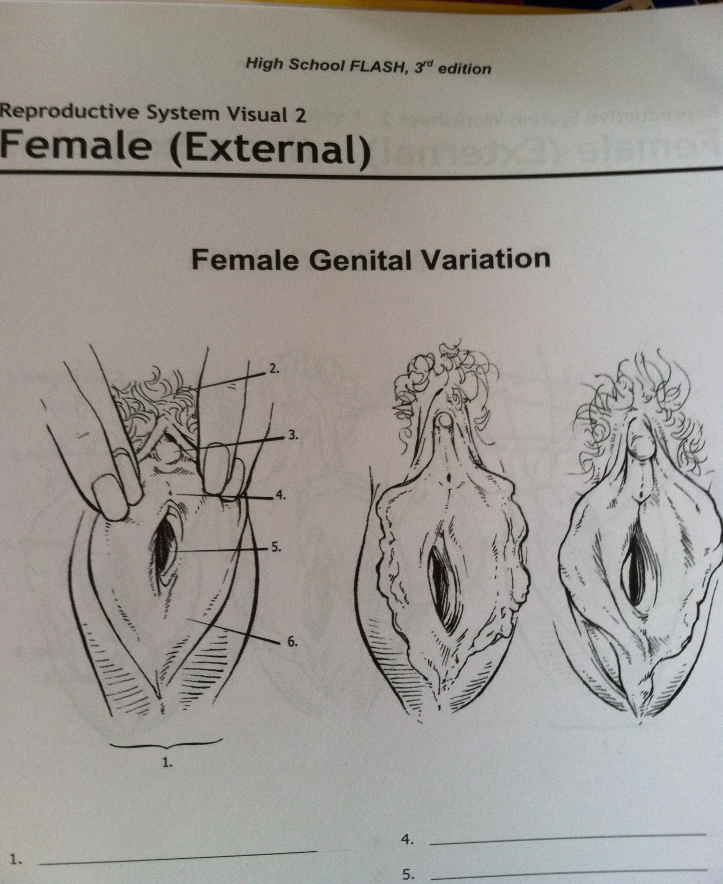
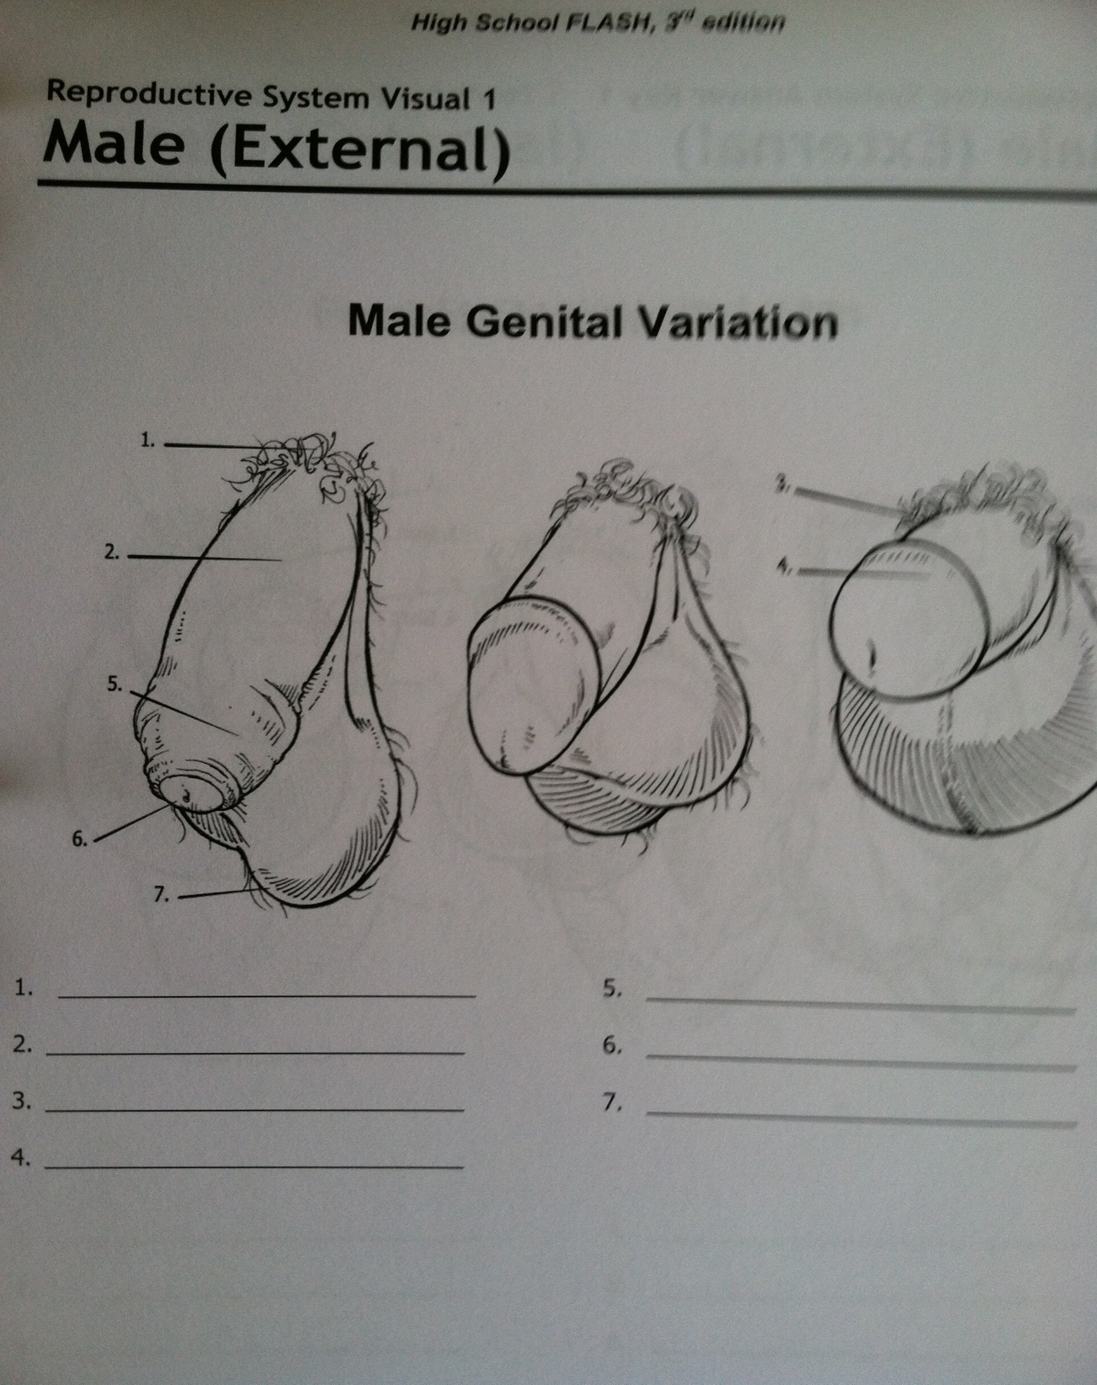

Slide 15
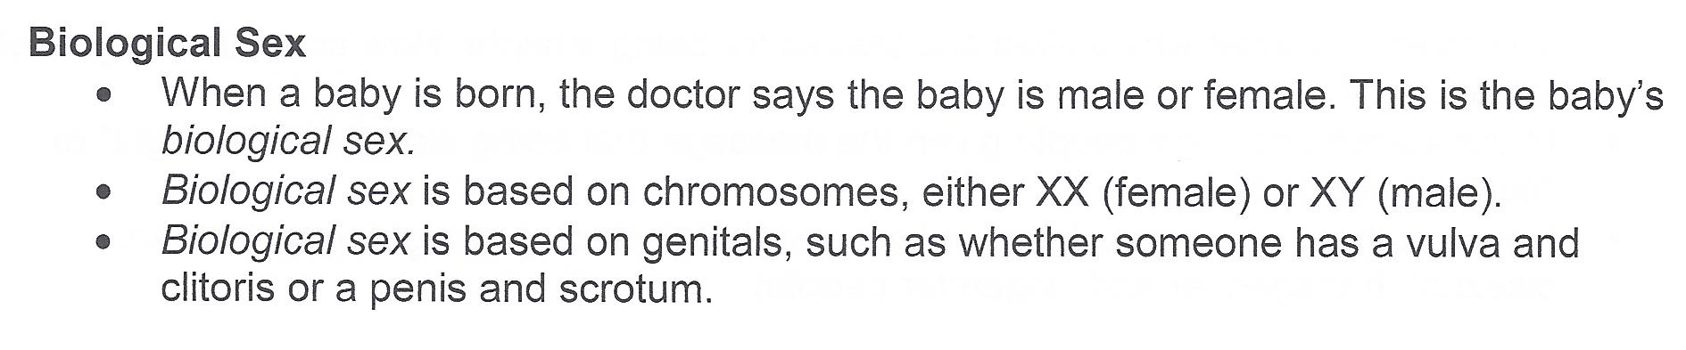
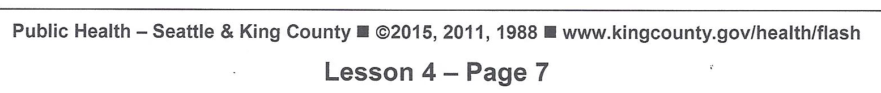

Slide 16
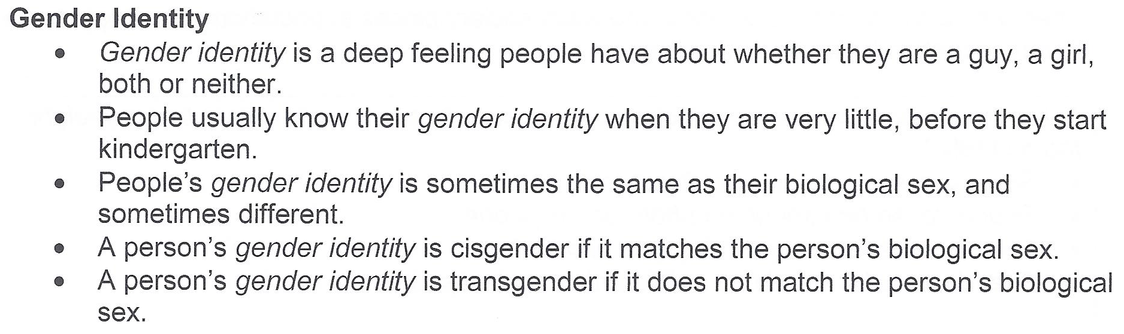

Slide 17
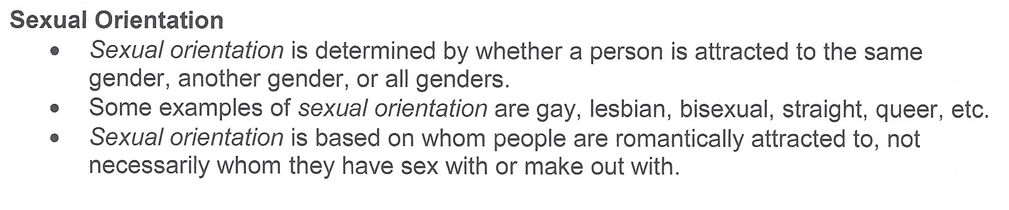

Slide 18
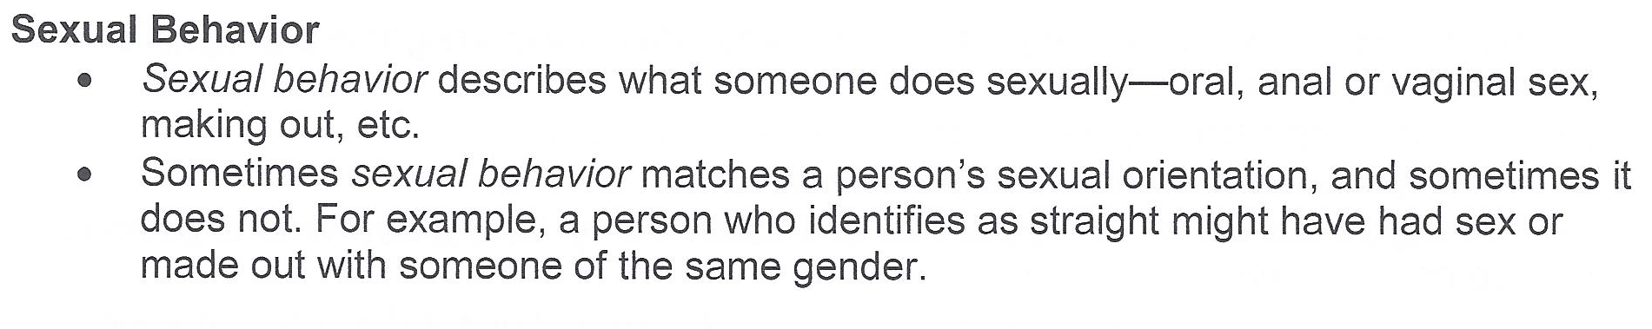

Slide 19
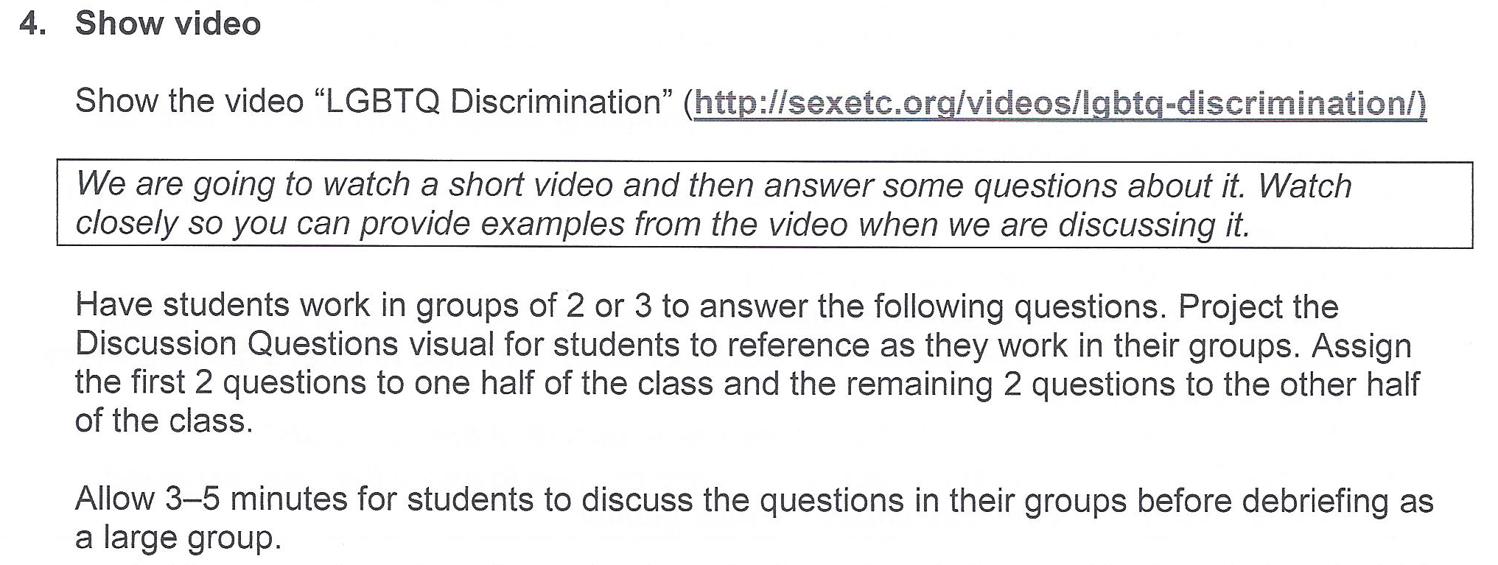

Slide 20
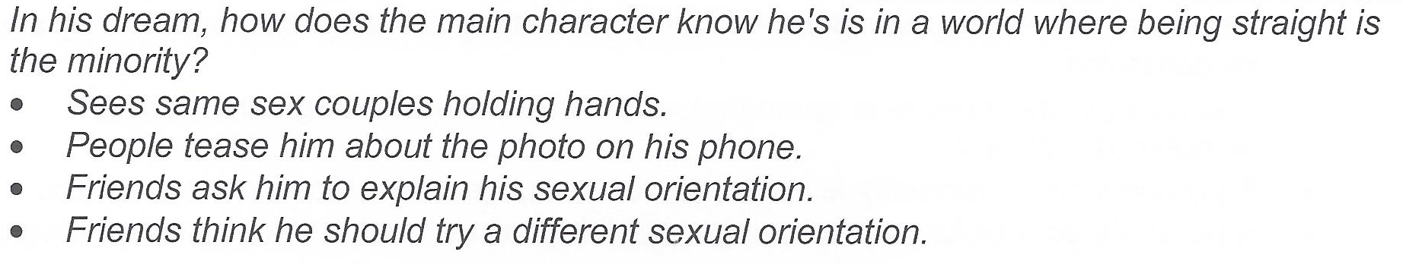

Slide 21
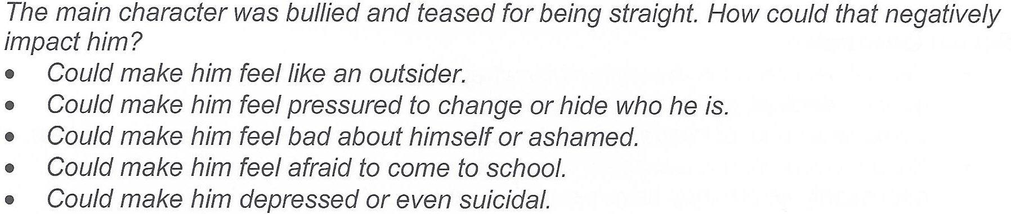

Slide 22
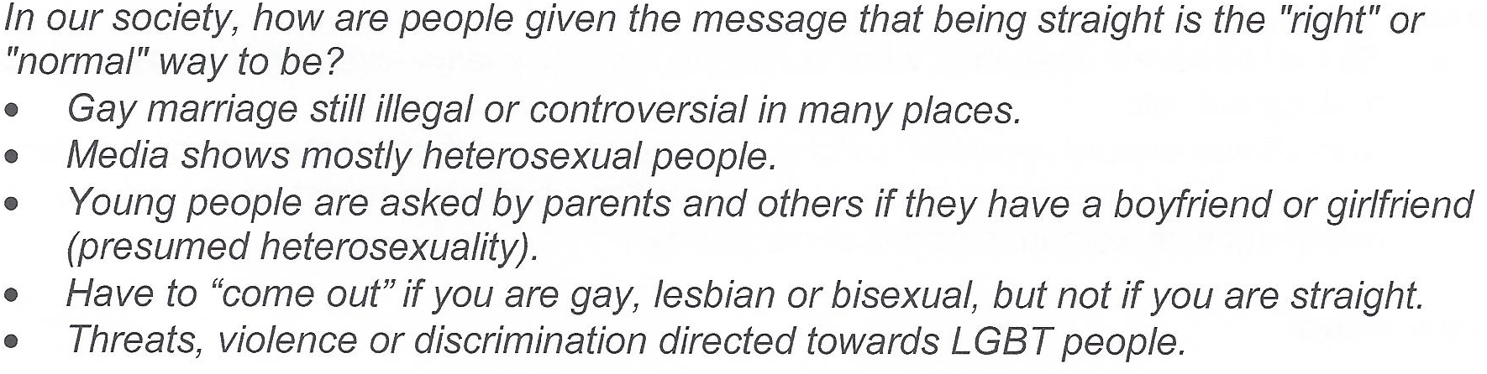

Slide 23
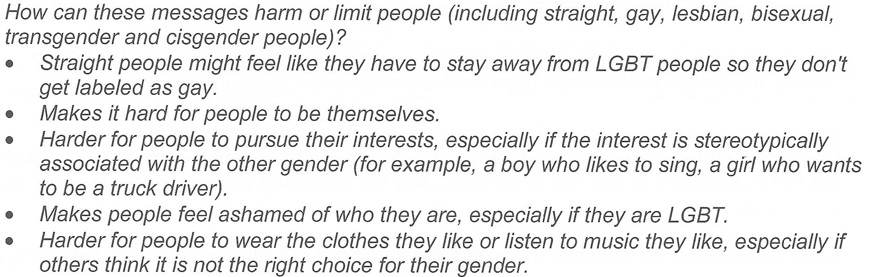

Slide 24
High School FLASH, 3rd Edition
Refusal Skills Scenario E
Small-Group Practice
Stacia and Grace are juniors in high school and have been best friends since the fifth grade. Grace has been with her
girlfriend, Brooklyn, for 3 months and is in love. Grace doesn’t want to have sex with Brooklyn. She thinks that she is
too young to have sex and doesn’t feel ready. Stacia started having sex with her boyfriend 2 months ago and is
pressuring Grace to also have sex.
(Be sure that in Grace’s responses to Stacia, she does not put Stacia down or call her any names for having made the
decision to have sex.)
Stacia: I can’t believe that you haven’t had sex with Brooklyn yet. I don’t know why you’re waiting. You should just
do it.
Grace: ________________________________________________________________________________________
________________________________________________________________________________________

Slide 25
High School FLASH, 3rd Edition
Gender Expectations Scenarios
Instructions: Complete the example scenario with the whole class. Be sure to fill in the answers on your sheet. You
will complete one of the other scenarios with your group.
Example: Bruno is feeling sad and hurt because his girlfriend broke up with him, but when his friends ask him how he
is, he says he’s glad they broke up and that he never cared about her anyway.
What traditional expectation of men is likely influencing Bruno’s actions?
On Saturday night, Aleesha had sex with her girlfriend even though she wasn’t in the mood because she didn’t want to hurt her girlfriend’s feelings.
What traditional expectation of women is likely influencing Aleesha’s actions?

Slide 26
High School FLASH, 3rd Edition Lesson 10 - Page 8
2. Explain purpose of lesson
The purpose of this lesson is for students to learn that birth control is excellent at preventing pregnancy,
regardless of whether they need to prevent pregnancy right now.
Hand out the Sexual Health Resources. Give information about where teens can get birth control in your
community, including whether it is confidential and free.
We are learning about birth control because birth control is great at preventing pregnancy. Gay, lesbian, bisexual, and straight teens all need to learn about birth control and STD prevention.
Some students need to know about how to prevent pregnancy right now because they’re having vaginal intercourse, or they will in the next few years.

Slide 27
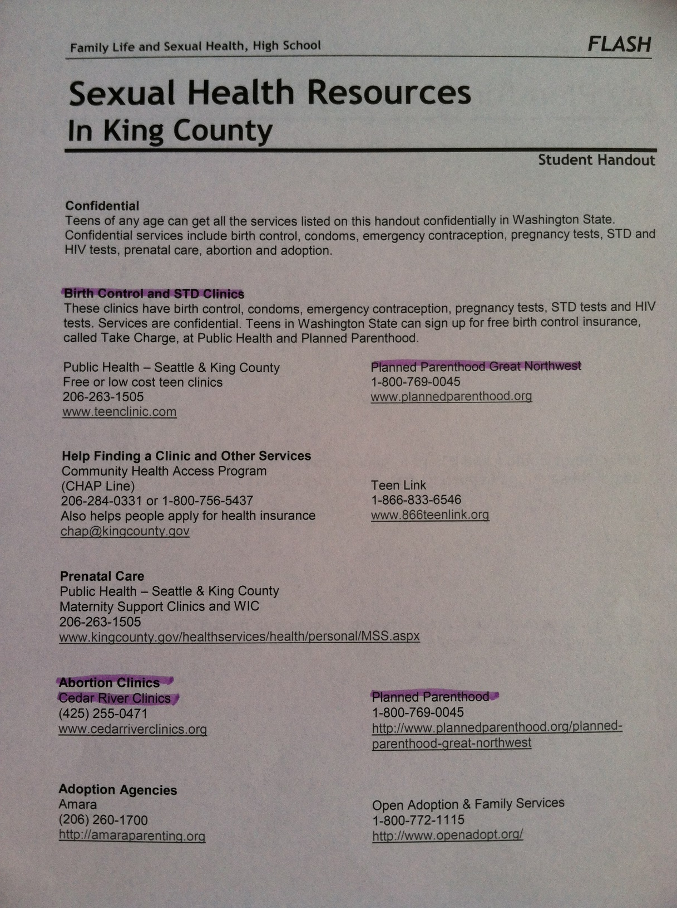

Slide 28
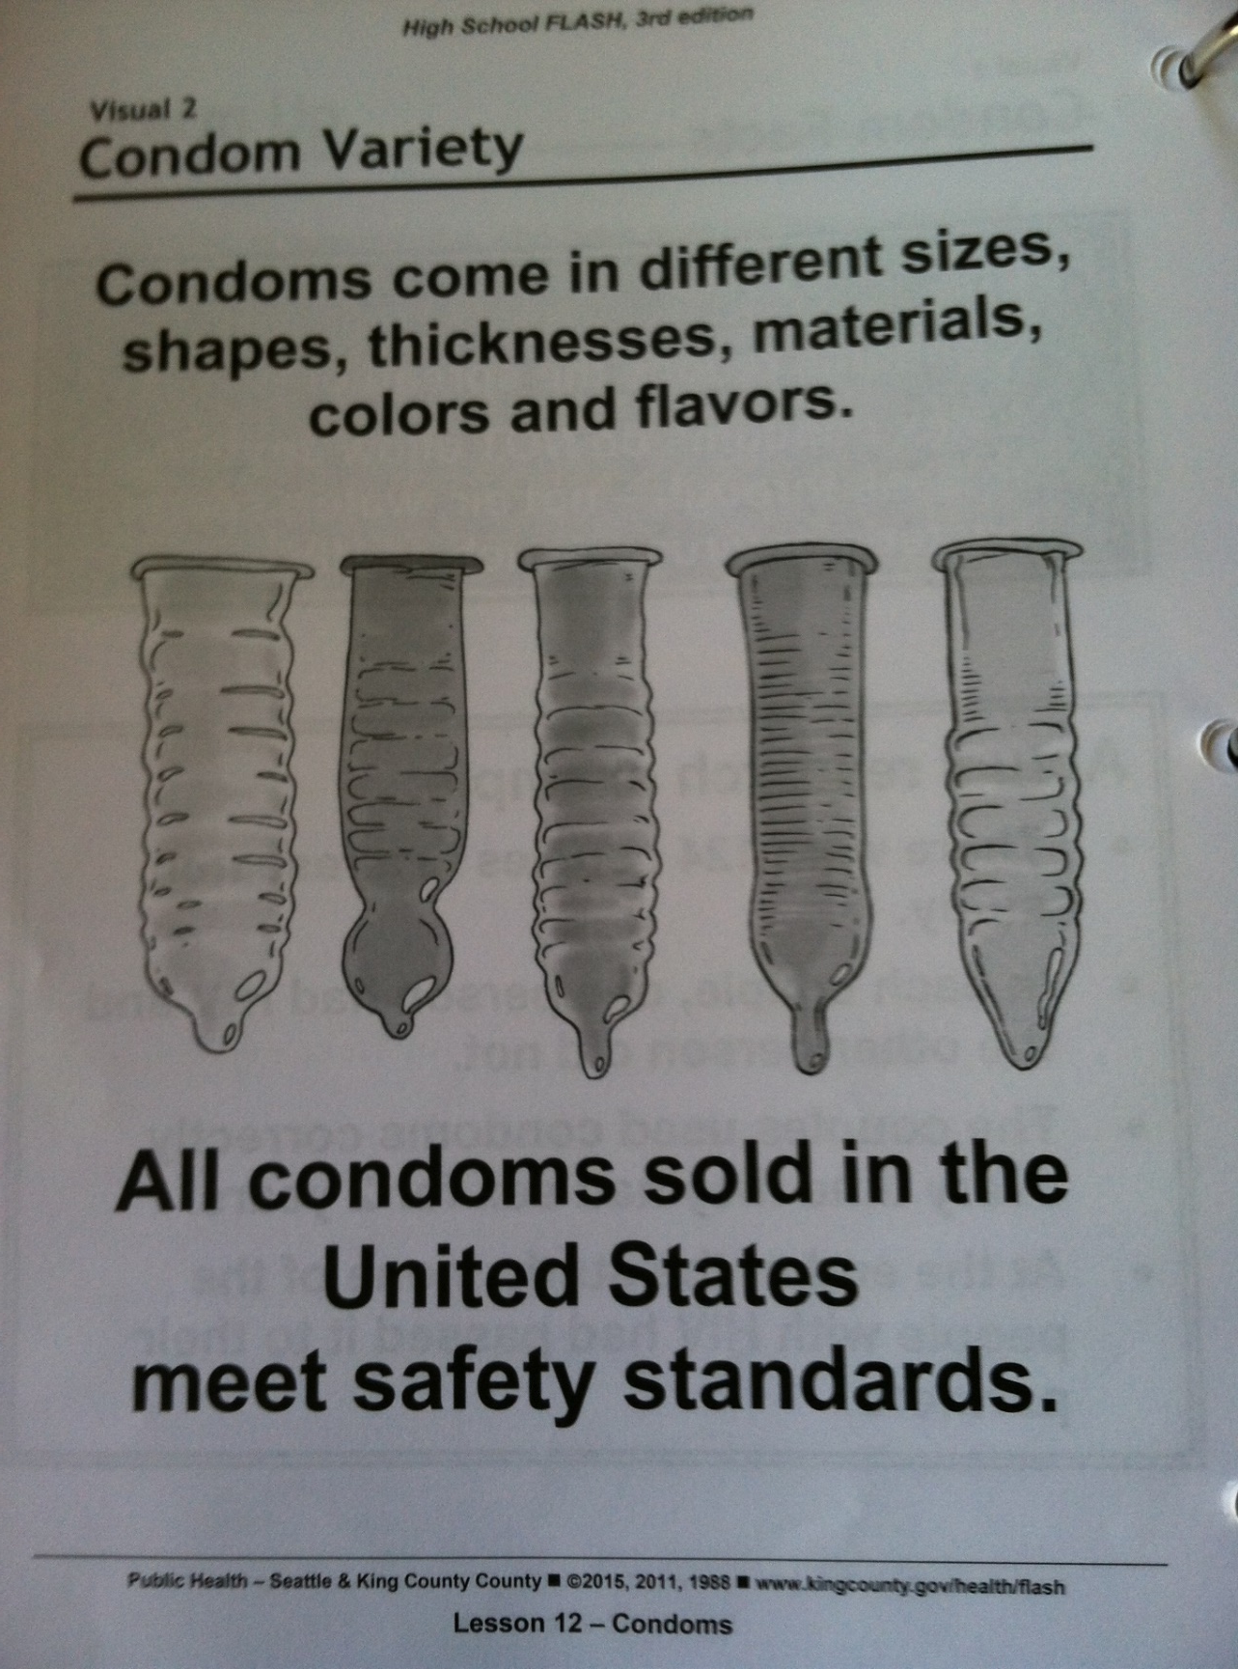
High School FLASH, 3rd Edition
Condom information, condom pictures,
condom demonstration, condom practice.
Warm Up
Choose one of the following statements and write 1 or 2
sentences about why you agree with it.
Condoms are easy to get and easy to use.
One great thing about condoms is that they prevent
both pregnancy and STD’s.
When I have sex, I will use condoms.

Slide 29
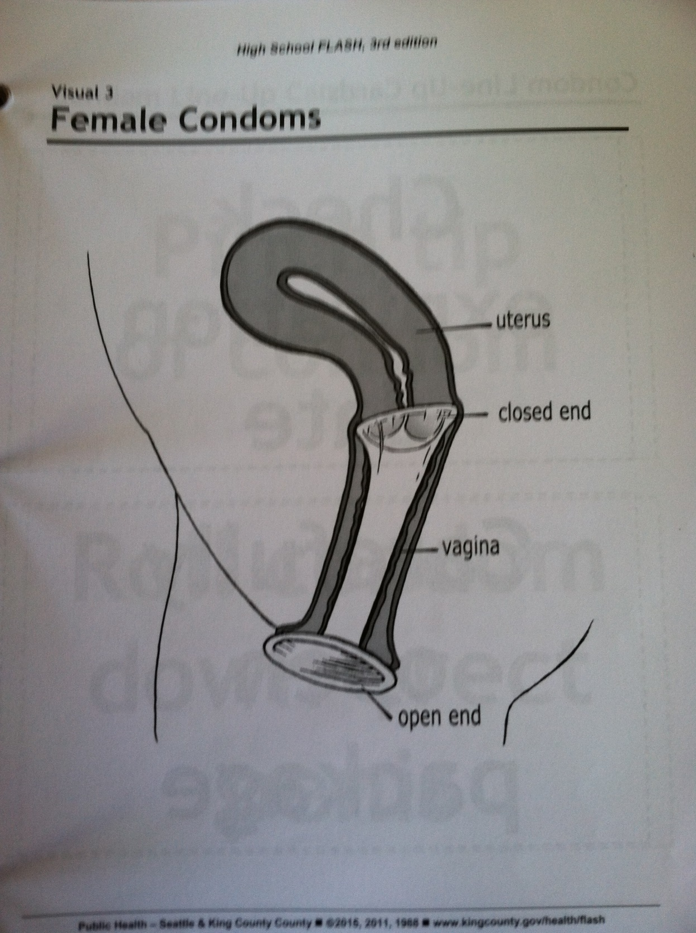
High School FLASH, 3rd Edition
Discuss the effectiveness of condoms
A condom is a thin stretchy cover that is worn over the penis. It can be used during oral, anal or vaginal sex. It greatly lowers the chance of giving or getting HIV or another STD.
Demonstrate correct condom use and have students practice
Do not demonstrate with fruit or vegetables, as some people find this offensive….
6. Demonstrate correct use of female condom

Slide 30
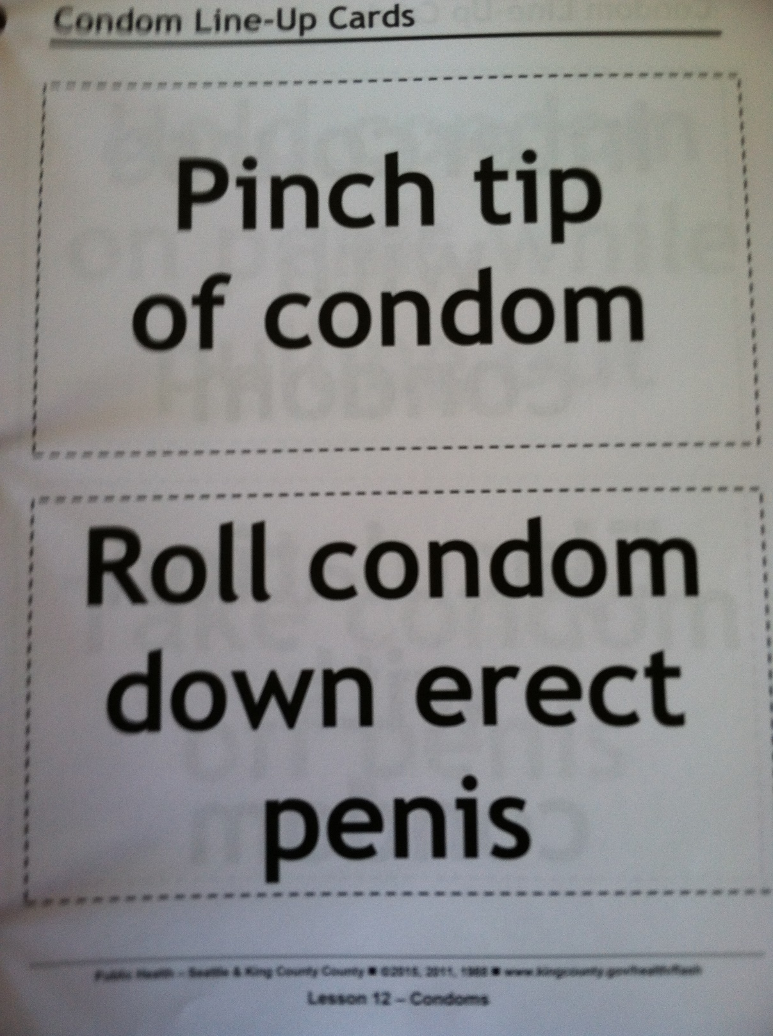
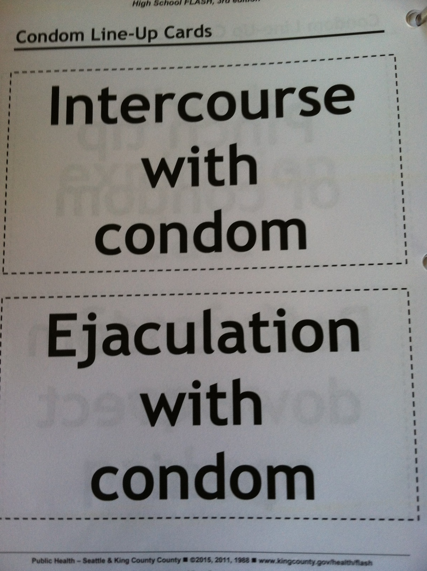

Slide 31
F.L.A.S.H.: Family Life and Sexual Health Grades 5-6, 7-8, 9-10,And 11-12
Elizabeth Reis, M.A. Seattle-King County Department of Public Health, Seattle, WA
SIECUS Report: Sexual Orientation , V.26 N.4
www.siecus.org, 14 Mar 2000 [cached]These pieces include "A Guide to Teaching Actively About Sexual Orientation" by Beth Reis of the Seattle-King Country Department of Public Health in Seattle

Slide 32

Elizabeth (Beth) Reis

Slide 33
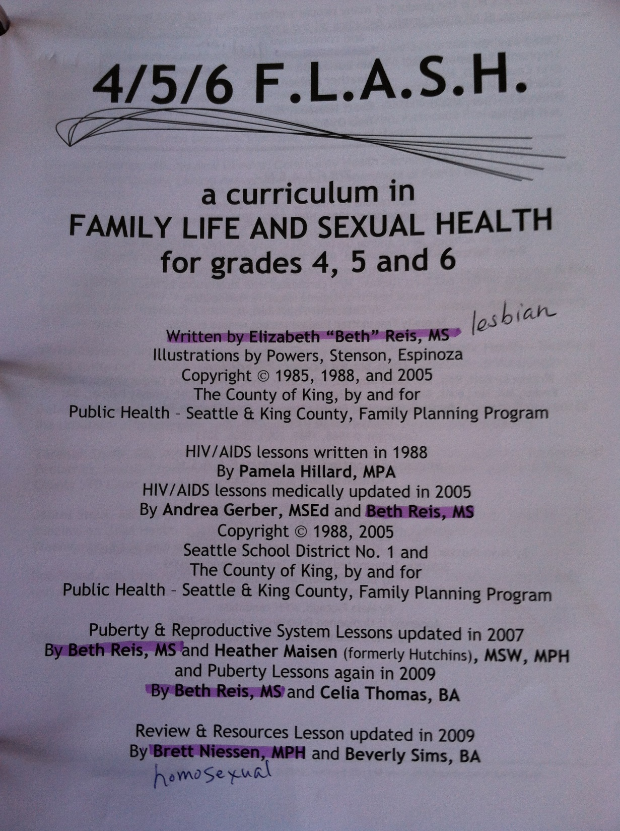

Brett Niessen

Slide 34
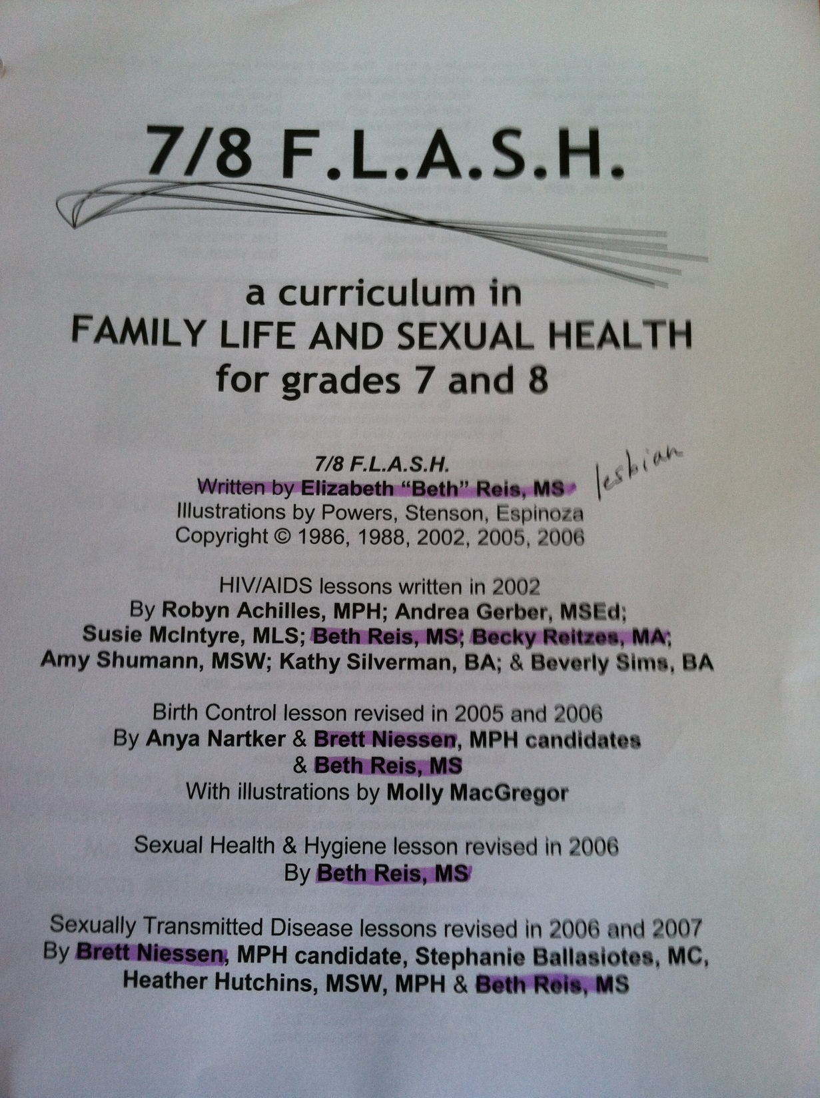

Slide 35



Kari Kesler
Becky Reitzes

