Slide 1
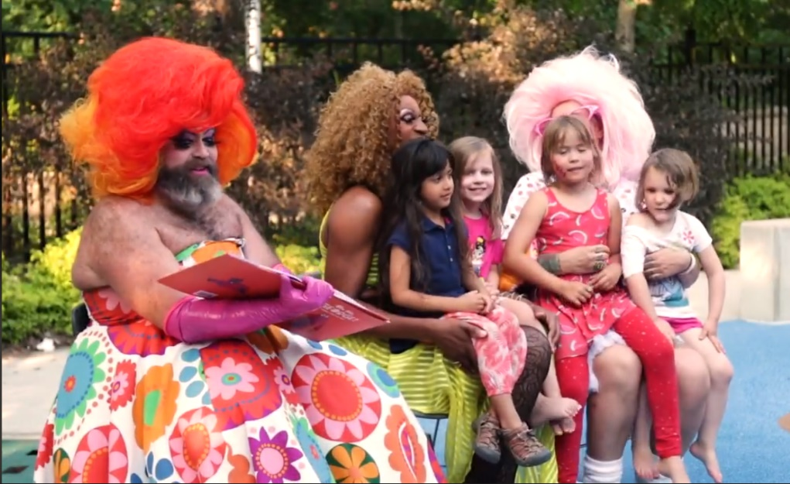
stop drag queen story hour

Slide 2
stop drag queen story hour
https://www.todaysparent.com/family/drag-queen-story-time/
https://www.fox10tv.com/news/protest-over-drag-queen-story-hour/article_809cd85c-aa41-11e8-9e7b-abbad09e0efe.html
https://nam03.safelinks.protection.outlook.com/?url=https%3A%2F%2Ffamilypolicyalliance.com%2Fissues%2F2018%2F09%2F11%2Freally-happens-drag-queen-story-hours%2F&data=02%7C01%7C%7Ce5e7bd5e16644c1bcdd808d63e3b257d%7C84df9e7fe9f640afb435aaaaaaaaaaaa%7C1%7C0%7C636764821077066692&sdata=v5h9hzhDmZC9oQRGwewz20m4JQz66fOqIojeXmbfwJI%3D&reserved=0
https://www.christiantoday.com/article/parents-are-right-to-protest-drag-queen-story-hours-for-children-says-franklin-graham/130396.htm
https://nam01.safelinks.protection.outlook.com/?url=https%3A%2F%2Fwww.anchoragepress.com%2Fprismpress%2Fstorybook-queens%2Farticle_7143281e-5485-11e8-afc7-878f0681ce0b.html&data=02%7C01%7C%7C55ab020497c54520099008d63b7922cf%7C84df9e7fe9f640afb435aaaaaaaaaaaa%7C1%7C0%7C636761788788461099&sdata=RJOK%2Byx%2Bofeeeyo6t5wfyja1a3CT3nBW5uy7YxporU4%3D&reserved=0

Slide 3
What is the origin of Drag queen story hour?
Drag Queen Story Hour was started in San Francisco by Michelle Tea and RADAR Productions.
RADAR Productions was created by Michelle Tea in 2003 as a place to house the underground queer literary programming that Michelle Tea had been involved with for a decade. RADAR conducts presenting, commissioning, professional development and touring programs that stimulate the production of queer and underground literature.
RADAR Productions is a San Francisco-based non-profit that produces literary happenings around the Bay Area and beyond.

Slide 4
What’s the objective of drag queen story hour?
DQSH’s website states “Drag Queen Story Hour is just what it sounds like-drag queens reading stories to children in libraries, schools, and bookstores. DQSH captures the imaginations and play of the gender fluidity of childhood and gives kids glamorous, positive, and unabashedly queer role models. In spaces like this, kids are able to see people who defy rigid gender restrictions and imagine a world where people can present as they wish, where dress up is real.”

Slide 5
What’s the objective of drag queen story hour?
DQSH’s website states that DQSH is designed for 3-8 year olds.
What is gender fluidity?
Some genderqueer people identify as a masculine woman or a feminine man or combine genderqueer with another gender option. A person who is gender fluid prefers to remain flexible about their gender identity rather than committing to a single gender.

Slide 6
PROGRAM
The program lasts about 45 minutes. The drag queen reads two or three picture books, interspersed with songs and movement activities, for 20-25 minutes. Then, the drag queen leads children in a craft activity. The program ends with a dance party.

Slide 7
venues
Most of the events are hosted at public libraries, but these DQSH also works with local bookstores, children’s museums, public and private schools, and other community organizations and spaces.

Slide 8
Funding
The DQSH website states “While it may be appropriate for some events to ask drag queens to donate their time, we recommend offering some form of payment or stipend to drag queens-you can discuss the rate and terms directly. Libraries, local organizations and/or venues may be able to offer financial support, and/or you may decide to pass a hat. Please note that DQSH is a non profit venture and should not be used to generate money for any business or corporations.”

Slide 9
Funding
The DQSH website states “While it may be appropriate for some events to ask drag queens to donate their time, we recommend offering some form of payment or stipend to drag queens-you can discuss the rate and terms directly. Libraries, local organizations and/or venues may be able to offer financial support, and/or you may decide to pass a hat. Please note that DQSH is a non profit venture and should not be used to generate money for any business or corporations.”

Slide 10
books
DQSH utilizes over fifty pro-homosexual picture books written for preschool and grade school children. Some of the titles include William’s Doll, Worm Loves Worm, and I Am Jazz.
Children are also introduced to the “Dragtivity Book,” which teaches children how to “create your own drag name” as well as “circle your pronouns.”

Slide 11
trainings
DQSH encourages training for drag queens if they aren’t experienced in early childhood education. DQSH states that Libraries may be able to provide trainings.

Slide 12
Is this child abuse?
TFP Student Action Director, John Ritchie, stated “I’ve never seen anything so vile that targets children so young. We’re talking about children. Toddlers who aren’t old enough to know their ABCs yet are getting pro-transgender and pro-homosexual ideas rammed down their throats at public libraries. It makes me sick-literally.” He continues “The homosexual movement is marketing sin to innocent children at younger and younger ages.” Ritchie continues “Children are being conditioned to believe that it’s normal and possible for a boy to become a girl and vice versa. A perverse culture of sin is poisoning minds to accept intrinsically disordered passions and reject reality and biology”
The American College of Pediatricians warns: “Conditioning children into believing that a lifetime of chemical and surgical impersonation of the opposite sex is normal and healthful is child abuse.”

Slide 13
Drag queen story hour in alaska
Since 2015, DQSH has been happening all over the country.
June 14, 2017 James Hoagland who is also known as GiGi Monroe, read to children at the Douglas Public library in Juneau. Soon after plans were made to do the same in Anchorage.
May 5, 2018 first DQST event hosted at the Loussac Public Library
June 9, 208 second DQST event hosted at the Loussac Public Library
October 20, 2018 2 events took place at the Loussac Public Library
Drag Storytime for children & families
Age groups targeted: Infants, Toddlers, Preschool
Drag Storytime for teens & adults
Age groups targeted: Teen, Adult

Slide 14
Anchorage sponsors
Identity, Inc.
Identity is a statewide LGBT organization founded in 1977 as a non-profit corporation and is based in Anchorage, AK.
Identity’s mission is to advance Alaska’s LGBT community through advocacy, education and connectivity.

Slide 15
objectives
Our objection is against the actions of the Loussac Public Library. We don’t want the library partnering with DSQH and promoting their agenda and we don’t want the library to host these types of events for children in a public building that is funded by taxpayers.
DQSH’s website states that DQSH is designed for 3-8 year olds. This type of program is completely inappropriate for children. The DQSH is a subversive introduction of an agenda which promotes gender fluidity and other paraphilias. These mature themes should not be introduced to children and these adult subjects have no place in a public library.

Slide 16
objectives
The Drag Queen Story Hour is not about love, acceptance and tolerance rather its about indoctrinating children to the ideals of secular humanism.
DQSH’s website states “Drag Queen Story Hour is just what it sounds like-drag queens reading stories to children in libraries, schools, and bookstores. DQSH captures the imaginations and play of the gender fluidity of childhood and gives kids glamorous, positive, and unabashedly queer role models. In spaces like this, kids are able to see people who defy rigid gender restrictions and imagine a world where people can present as they wish, where dress up is real.”

Slide 17
PRO-FAMILY ORGANIZATIONS that SUPPORT THE REMOVAL OF DRAG QUEEN STORY HOUR

Slide 18
Next steps
PRAY!!!
Put your name down in support of stopping DSQH at the Loussac Public Library
Sign petition that will be emailed to the Mayor, Assembly Members and the Director for the Anchorage Public Library
Once we have generated enough support, attend Assembly Meeting (date tbd)

